Slide 1
  Overview of Portal Status and Portal Beta Testing

Slide 2
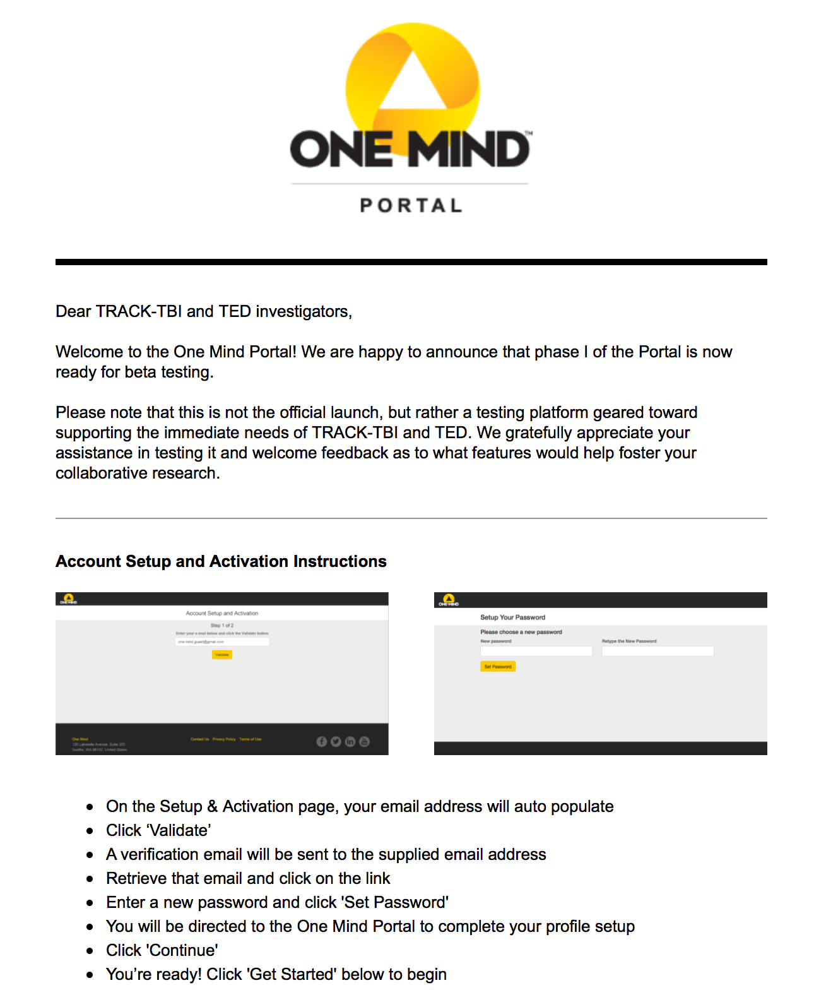
Roll-Out of Portal Beta TEST
TRACK-TBI PILOT Data
  Initially TRACK-TBI investigators
  Added TED investigators
Current TRACK data
  TRACK-TBI and TED
  Availability March 2016
Center-TBI data
  Initial beta test group
  Begin March/April 2016
  Expand user base over 2016
FITBIR data import
  Initial integration 2nd qtr 2016
National Network of Depression Centers data
  Agreements being reviewed
Palantir application integration
  Gaining necessary approvals for access
Addition of new testers
Increasing available data

Slide 3
Portal Challenge
Goal: Increase user engagement via portal based challenges
Initial challenge conducted Fall 2015 with TRACK Pilot data
Additional challenges currently being discussed

Slide 4

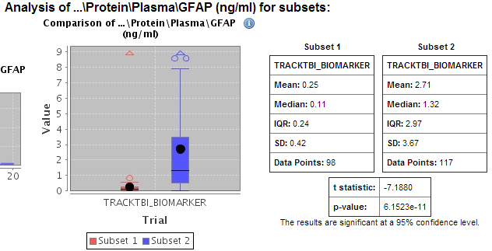
  Integration of Additional Datasets within Portal

Slide 5
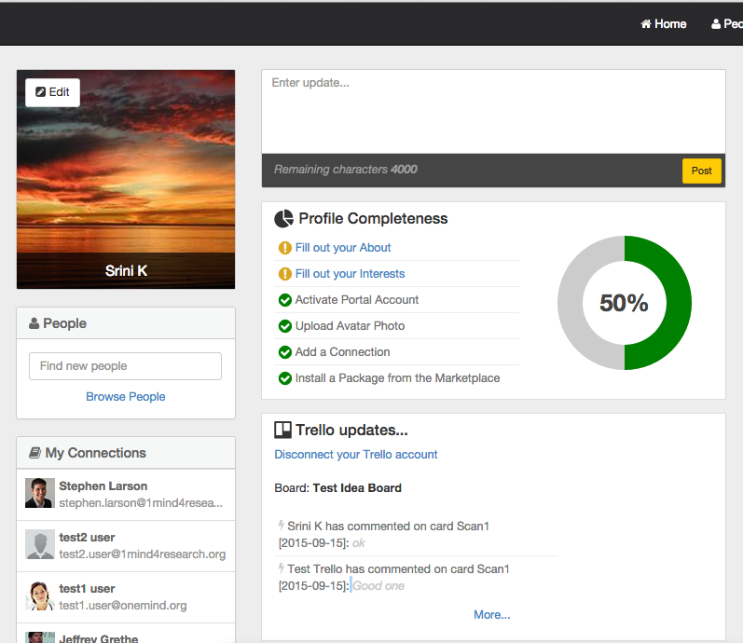
Collaboration Tools
“to access a digital white board to keep track of our ongoing research projects and know who is working on what”
Working closely with Geoff Manley and selected users
Developed use cases via online screen sharing sessions
Initial integration of collaboration tool complete
Will review progress and further refine use cases through Beta test

Slide 6
Expanding User Base
TRACK & TED
  Newer and more relevant data -> current TRACK data
  TED data being curated by Palantir
  Open access to graduate and postdoctoral researchers
Center-TBI
  Working closely with INCF applications developer to configure OM tranSMART installation
  Dedicated testing group (10-20 investigators) to start in 2016
  Progressively open access over 2016

Slide 7
Future Integrations
Additional tranSMART data
  Curation of additional high-value data sets
  Outreach around data sets
Palantir Data
  Currently curating TED data
Patients Like Me Data
FITBIR
  Provides standardized data access
  New portal app to automatically add data to personal space
  Builds on OM tranSMART app & INCF data ingestion tools

